Slide 1
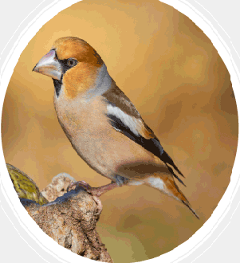
PRESENTATION ON AVES

Slide 2
CONTENTS
INTORDUCTION
WHAT IS AVES?
CHARACTERISTICS OF AVES
CLASSIFICATION OF AVES
BIBLIOGRAPHY
CREDITS

Slide 3
WHAT IS AVES?
AVES IS A CLASS OF VERTEBRATES WHICH COMPRISES ALL THE BIRDS. THEY BELONG TO THE PHYLUM CHORDATA OF THE ANIMAL KINGDOM WHICH HAS 9000 SPECIES. THEY CONSIST OF ALL THE BIRDS WHICH ARE ADAPTED TO FLY AND ALSO SHOW PARENTAL CARE, NEST BUILDING AND TERRETORIAL BEHAVIOR.

Slide 4
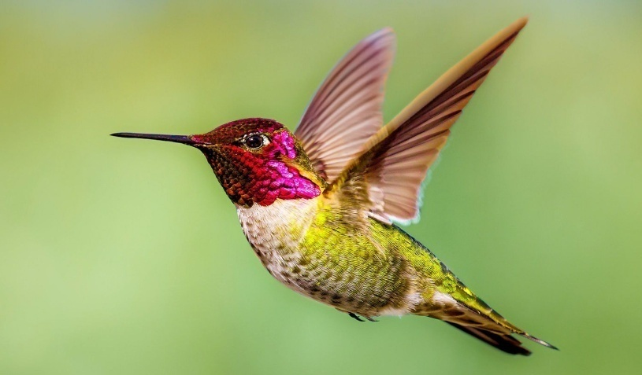
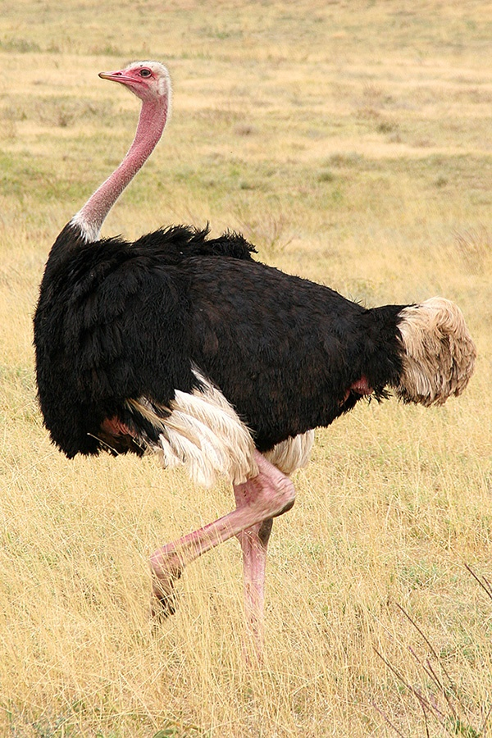
CHARACTERISTICS OF AVES
They are warm-blooded animals and have a four-chambered heart.
They have an outer covering of feathers.
They have two forelimbs which are modified for flight.
They breathe through their lungs.

Slide 5
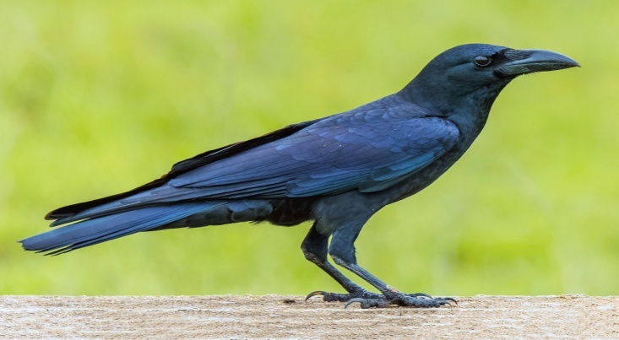
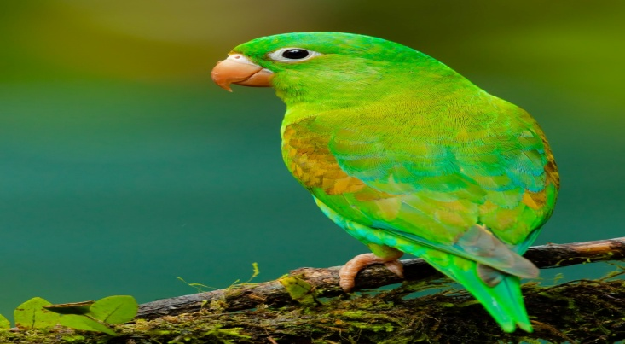
CHARACTERISTICS(contd.)
Their hind limbs are adapted for walking hopping, perching, grasping, wading and swimming.
They have epidermal scales on their legs.
They have spongy and elastic lungs for respiration.

Slide 6
CHARACTERISTICS(contd.)
Their heart is four-chambered.
They have sharp eyesight.
12 pairs of cranial nerves are present.
They have single ovary and oviduct on the left side.
The only skin gland present is the oil gland.
The special vocal organ called syrinx is present at the base of trachea.
All the birds are oviparous and exhibit sexual dimorphism.
The feathers help in preventing heat loss and reduce air friction by providing passage to the air.

Slide 7
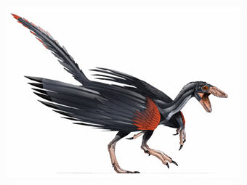
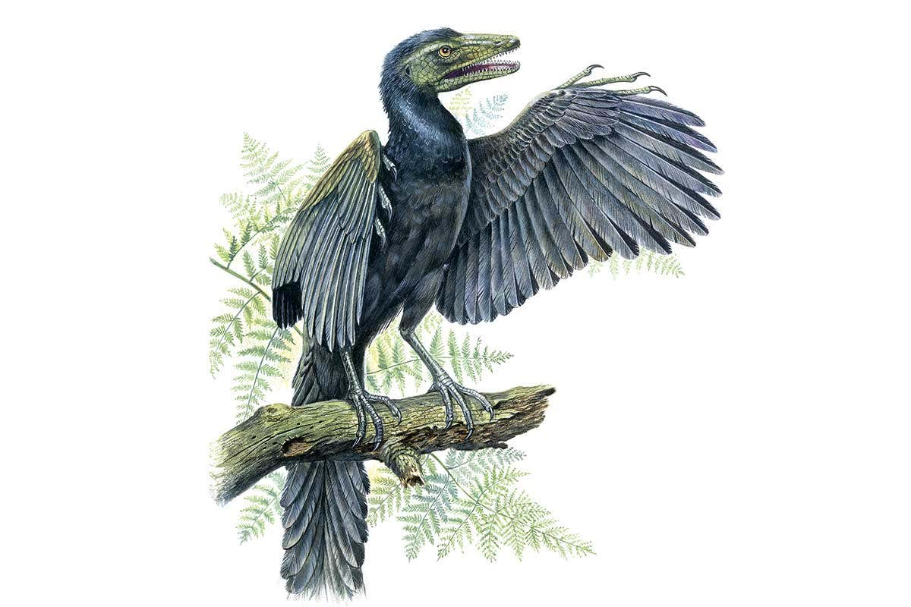
CLASSIFICATION OF AVES
The 2 types of AVES present are:-
THE FIRST TYPE OF AVES
ARCHAEORNITHES-This class of birds is
extinct. They had a toothed beak with a
long lizard-like tail.
Examples- Achaeopteryx

Slide 8
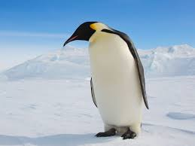
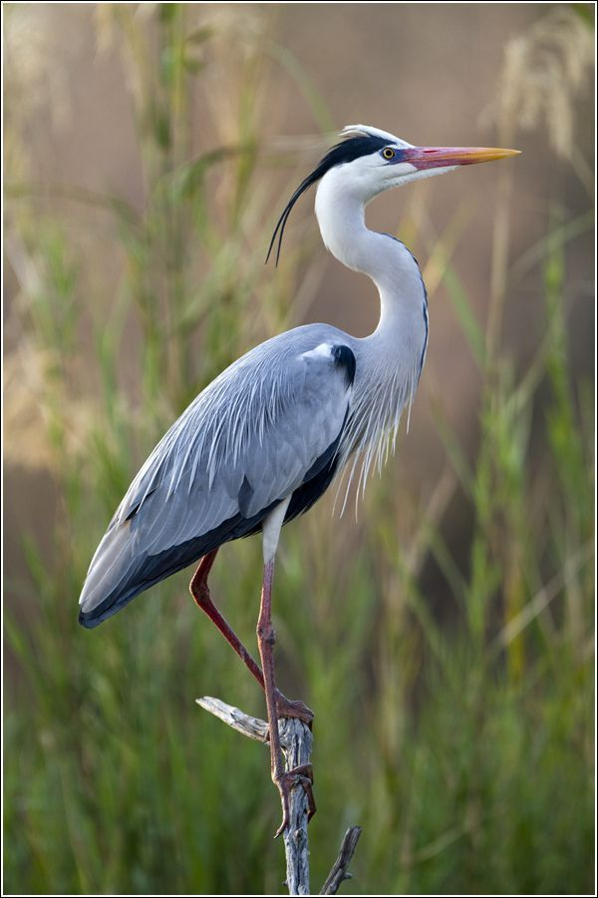
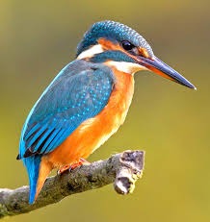
SECOND TYPE OF AVES
Neornithes- These include extant as well
as extinct birds. They have no teeth and
short tail.
Examples- Penguin, Grey Heron,
Kingfisher, Duck, etc.

Slide 9
BIBLIOGRAPHY
https://byjus.com/biology/aves/
https://en.wikipedia.org/wiki/Bird
Class 9 Science NCERT textbook .
Science for class 9 by Dr. PS Verma and Dr. VK Agarwal.

Slide 10
CREDITS
Creators:-
Arjun Gulati (9-A)-roll no.3
Johan Abraham(9-A)-roll no.

Slide 11
THANK YOU

